Slide 1



SRI KRISHNA COLLEGE OF ENGINEERING AND TECHNOLOGY
Kuniamuthur, Coimbatore, Tamilnadu, India
An Autonomous Institution, Affiliated to Anna University,
Accredited by NAAC with “A” Grade & Accredited by NBA (CSE, ECE, IT, MECH ,EEE, CIVIL& MCT)
Topic : ADT-LIST
www.skcet.ac.in

Slide 2
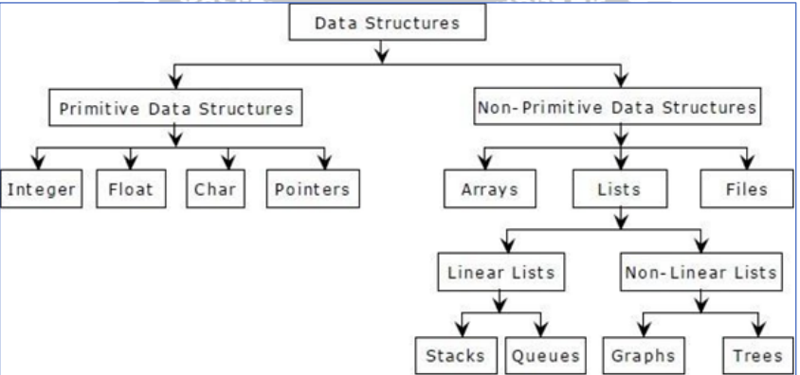

Slide 3
Abstract Data type
The abstract datatype is special kind of datatype, whose behavior is defined by a set of values and set of operations
Three ADTs namely
List ADT
Stack ADT
Queue ADT

Slide 4
List ADT
A list contains elements of same type arranged in sequential order.
List can be implemented in two ways:
1. Array based Implementation
2. Linked List Implementation

Slide 5
ARRAY IMPLEMENTATION
An array is a collection of items stored at contiguous memory locations
The basic operations are: a
. Creation of a List.
b. Insertion of a data in the List
c. Deletion of a data from the List
d. Searching of a data in the list

Slide 6
Global Declaration:
int list[25], index=-1;
Note: The initial value of index is -1.

Slide 7
Create Operation: Procedure
The list is initially created with a set of elements. Get the no. of elements (n) to be added in the list.
Check n is less than or equal to maximum size.
If yes, add the elements to the list.
Otherwise, give an error message

Slide 8
Creation - Routine
void create()
{
int n,i;
printf("\nEnter the no.of elements to be added in the list");
scanf("%d",&n);
if(n<=maxsize)
for(i=0;i<n;i++)
{
scanf("%d",&list[i]);
index++;
}
else
printf("\nThe size is limited. You cannot add data into the list");
}

Slide 9
Insert Operation: Procedure:
Get the data element to be inserted.
Get the position at which element is to be inserted.
If index is less than or equal to maxsize, then Make that position empty by altering the position of the elements in the list.
Insert the element in the Position.
Otherwise, it implies that the list is empty.

Slide 10
Insertion - Routine
void insert()
{
int i,data,pos;
printf("\nEnter the data to be inserted"); scanf("%d",&data);
printf("\nEnter the position at which element to be inserted");
scanf("%d",&pos);
if(index=pos-1;i--)
list[i+1]=list[i];
index++;
list[pos-1]=data;
}
else
printf("\nThe list is full"); }

Slide 11
Deletion Procedure
• Get the position of the element to be deleted. • Alter the position of the elements by performing an assignment operation, list[i-1]=list[i], where i value ranges from position to the last index of the array

Slide 12
Deletion Routine
void del()
{
int i,pos;
printf("\nEnter the position of the data to be deleted");
scanf("%d",&pos);
printf("\n The data deleted is %d",list[pos-1]); for(i=pos;i<=index;i++)
list[i-1]=list[i];
index--;
}

Slide 13
Display Procedure
• Formulate a loop, where i value ranges from 0 to index (index denotes the index of the last element in the array.
• Display each element in the array.

Slide 14
Display Routine
void display()
{
int i;
for(i=0;i<=index;i++)
printf("\t%d",list[i]);
}

Slide 15
Disadvantage
Insertion and deletion are expensive
Even if the array is dynamically allocated, an estimate of the maximum size of the list is required

